Slide 1

A Data-driven Particle Filter Approach for System-Level Prediction of Remaining Useful Life
Abel Diaz-Gonzalez, Austin Coursey, Marcos Quinones-Grueiro, and Gautam Biswas

Slide 2


Motivation

Slide 3
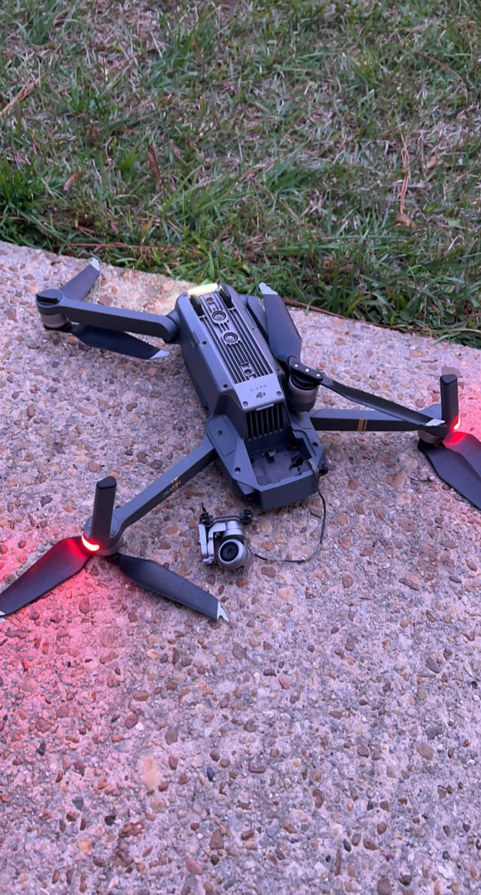
Safe Continual RL
Motivation
Accurate RUL estimation is key for predictive maintenance
Prevents unexpected failures and costly downtime.
Improves safety and reduces life-cycle costs.
Existing approaches have drawbacks
Model-based: interpretable, but need accurate physics models
Data-driven: scalable, but often black-box and usually lacks uncertainty estimation.
Hybrid: combine both, but inherit challenges (modeling cost + data requirements)
How to obtain interpretable, uncertainty-aware RUL predictions without relying on expert knowledge or system models?
NASA/JPL-Caltech

Slide 4

Background

Slide 5

Particle Filter (PF)
PFs are a class of Bayesian filters that use sequential Monte Carlo sampling to approximate the posterior distribution of latent variables with a set of weighted samples or “particles”.
At time step $k$, the goal is to estimate the posterior distribution of the latent variable $X_{k}$ given all observations $y_{0:k}$.
This posterior is often referred as the belief ${bel}_{k}$ and is computed in two recursive steps:
$$bel_{k}\left(x_{k}\right)≔p\left(X_{k}=x_{k} | Y_{0:k−1}=y_{0:k−1}\right)=∫p\left(x_{k} | x_{k−1}\right){\overline{bel}}_{k−1}\left(x_{k−1}\right)dx_{k−1}$$
(prediction)
$${\overline{bel}}_{k}\left(x_{k}\right)≔p\left(X_{k}=x_{k} | Y_{0:k}=y_{0:k}\right)∝p\left(y_{k} | x_{k}\right)bel_{k}(x_{k})$$
(correction)
Notice that the particle filtering framework depends only on the transition $p\left(x_{k} | x_{k−1}\right)$ and sensor $p\left(y_{k} | x_{k}\right)$ models and the initial distribution of the latent variable $bel_{0}\left(x\right)=p\left(X_{0}=x\right).$

Slide 6

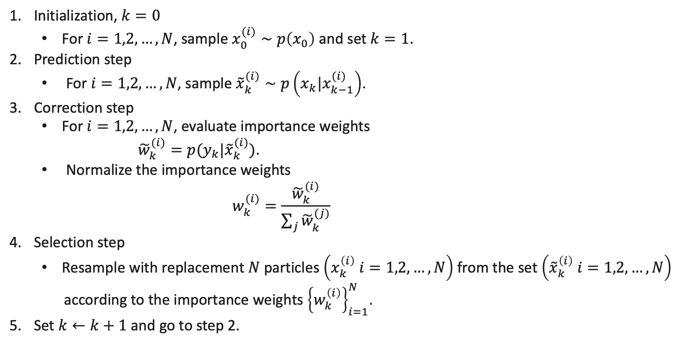
Bootstrap Particle Filter ($N$ particles)
Initialization, $k=0$
For $i=1,2,…,N$, sample $x_{0}^{(i)}∼p\left(x_{0}\right)$ and set $k=1$.
Prediction step
For $i=1,2,…,N$, sample ${\tilde{x}}_{k}^{(i)}∼p\left(x_{k}|x_{k−1}^{(i)}\right)$.
Correction step
For $i=1,2,…,N$, evaluate importance weights
${\tilde{w}}_{k}^{(i)}=p(y_{k}|{\tilde{x}}_{k}^{(i)})$.
Normalize the importance weights
$$w_{k}^{(i)}=\frac{{\tilde{w}}_{k}^{(i)}}{\sum_{j}{{\tilde{w}}_{k}^{(j)}}}$$
Selection step
Resample with replacement $N$ particles $\left(x_{k}^{\left(i\right)} i=1,2,…,N\right)$ from the set $\left({\tilde{x}}_{k}^{\left(i\right)} i=1,2,…,N\right)$
according to the importance weights ${\left\{w_{k}^{\left(i\right)}\right\}}_{i=1}^{N}$.
Set $k←k+1$ and go to step 2.

Slide 7

Method

Slide 8
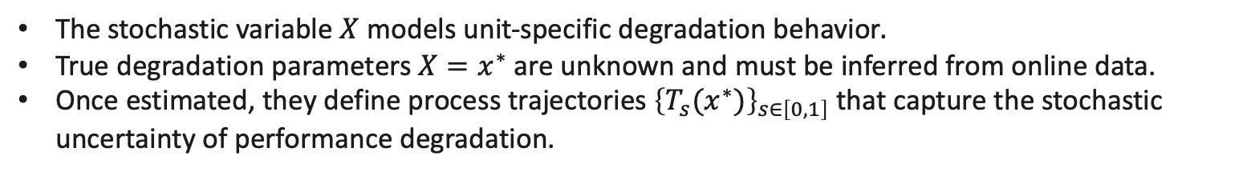
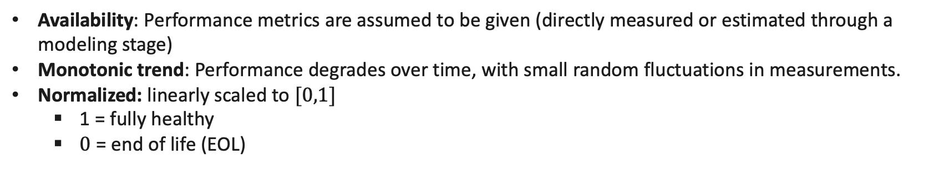
Assumptions on Performance metrics
Availability: Performance metrics are assumed to be given (directly measured or estimated through a modeling stage)
Monotonic trend: Performance degrades over time, with small random fluctuations in measurements.
Normalized: linearly scaled to $[0,1]$
1 = fully healthy
$0$ = end of life (EOL)
Stochastic Process:
We assume we know a performance metric model $T_{s}(x)$ that models the time at which the scaled performance metric reaches level $s$ with latent degradation parameter $x$, and consider the stochastic process:
$${\left\{T_{s}(X)\right\}}_{s∈\left[0,1\right]}$$
The stochastic variable $X$ models unit-specific degradation behavior$.$
True degradation parameters $X=x^{∗}$ are unknown and must be inferred from online data.
Once estimated, they define process trajectories ${\left\{T_{s}(x^{∗})\right\}}_{s∈\left[0,1\right]}$ that capture the stochastic uncertainty of performance degradation.

Slide 9
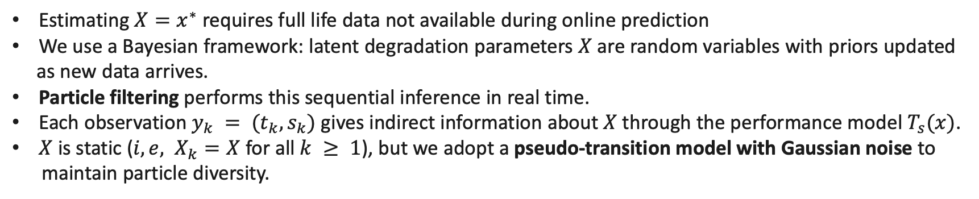
EOL Particle Filter – Transition and Sensor models
Estimating ${X=x}^{∗}$requires full life data not available during online prediction
We use a Bayesian framework: latent degradation parameters $X$ are random variables with priors updated
as new data arrives.
Particle filtering performs this sequential inference in real time.
Each observation $y_{k} = (t_{k}, s_{k})$gives indirect information about $X$through the performance model $T_{s}(x)$.
$X$ is static (${i,e, X}_{k}=X$ for all $k ≥ 1$), but we adopt a pseudo-transition model with Gaussian noise to
maintain particle diversity.
This leads to the following sensor and transition models:
Transition model: $p\left(x_{k} | x_{k−1}\right)= 𝒩\left(x_{k−1},Σ\right), Σ$is diagonal.
Sensor model: $p\left(y_{k} | x_{k}\right)=P\left(T_{s_{k}}=t_{k}\right|X_{k}=x_{k})=P(T_{s_{k}}(x_{k})=t_{k})$

Slide 10
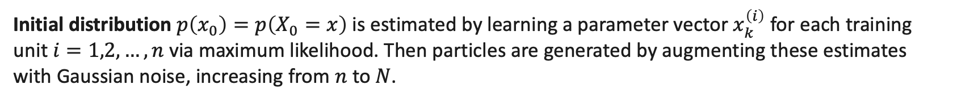
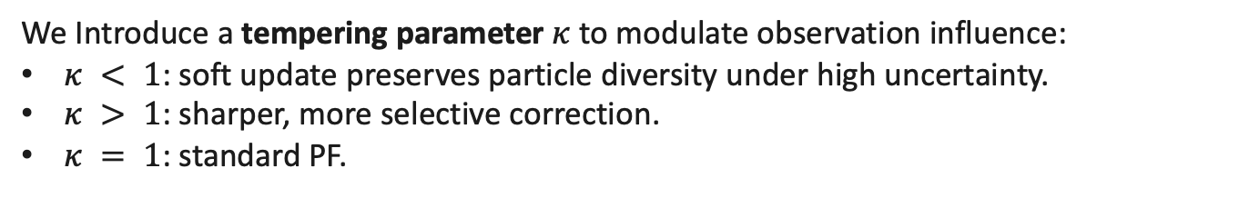
EOL Particle Filter
We use the standard bootstrap PF algorithm with a modified correction step for parameter inference.
We Introduce a tempering parameter $κ$to modulate observation influence:
$κ < 1$: soft update preserves particle diversity under high uncertainty.
$κ > 1$: sharper, more selective correction.
$κ = 1$: standard PF.
${\tilde{w}}_{k}^{(i)}=p{\left(y_{k} | {\tilde{x}}_{k}^{\left(i\right)}\right)}^{κ}$
$κ$and propagation noise variances ($Σ$) are learned offline as a function of the observation (not just as fixed constants) from historical data.
Initial distribution $p\left(x_{0}\right)=p\left(X_{0}=x\right)$ is estimated by learning a parameter vector $x_{k}^{\left(i\right)}$ for each training unit $i=1,2,…,n$ via maximum likelihood. Then particles are generated by augmenting these estimates with Gaussian noise, increasing from $n$ to $N$.

Slide 11

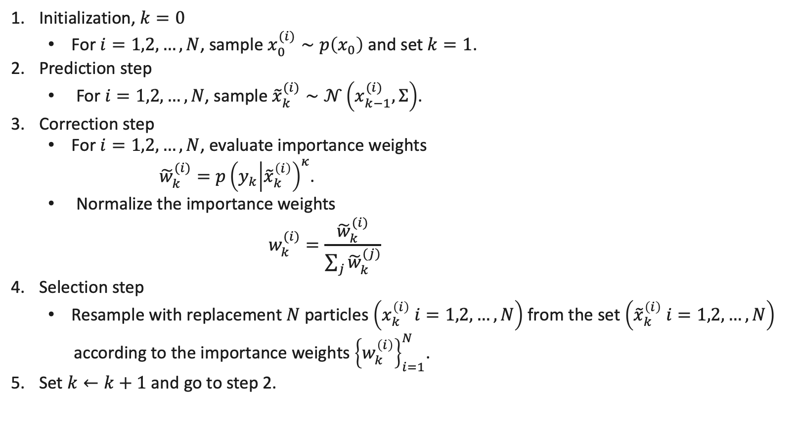
EOL Particle Filter ($N$ particles)
Initialization, $k=0$
For $i=1,2,…,N$, sample $x_{0}^{(i)}∼p\left(x_{0}\right)$ and set $k=1$.
Prediction step
For $i=1,2,…,N$, sample ${\tilde{x}}_{k}^{(i)}∼𝒩\left(x_{k−1}^{(i)},Σ\right)$.
Correction step
For $i=1,2,…,N$, evaluate importance weights
${\tilde{w}}_{k}^{(i)}=p{\left(y_{k} | {\tilde{x}}_{k}^{\left(i\right)}\right)}^{κ}$.
Normalize the importance weights
$$w_{k}^{(i)}=\frac{{\tilde{w}}_{k}^{(i)}}{\sum_{j}{{\tilde{w}}_{k}^{(j)}}}$$
Selection step
Resample with replacement $N$ particles $\left(x_{k}^{\left(i\right)} i=1,2,…,N\right)$ from the set $\left({\tilde{x}}_{k}^{\left(i\right)} i=1,2,…,N\right)$
according to the importance weights ${\left\{w_{k}^{\left(i\right)}\right\}}_{i=1}^{N}$.
Set $k←k+1$ and go to step 2.

Slide 12
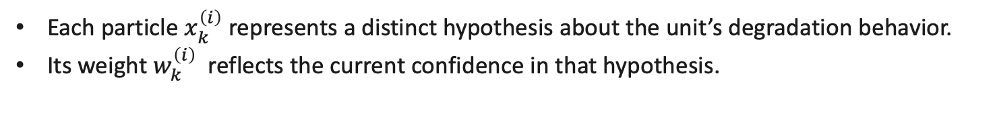
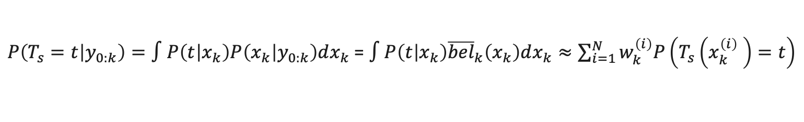
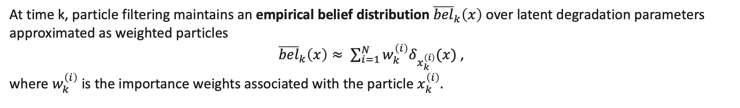
Predictive distribution
At time k, particle filtering maintains an empirical belief distribution ${\overline{bel}}_{k}\left(x\right)$ over latent degradation parameters approximated as weighted particles
${\overline{bel}}_{k}\left(x\right)≈ \sum_{i=1}^{N}{w_{k}^{\left(i\right)}δ_{x_{k}^{\left(i\right)}}(x)}$ ,
where $w_{k}^{\left(i\right)}$ is the importance weights associated with the particle $x_{k}^{\left(i\right)}.$
We use this empirical belief distribution to compute the predictive probability distribution of $T_{s}$, marginalizing over the posterior distribution of $X_{k}$
$P\left(T_{s}=t | y_{0:k}\right)=∫P\left(t | x_{k}\right)P\left(x_{k} | y_{0:k}\right)dx_{k}$ = $∫P\left(t | x_{k}\right){\overline{bel}}_{k}\left(x_{k}\right)dx_{k}≈\sum_{i=1}^{N}{w_{k}^{\left(i\right)}P\left(T_{s}\left(x_{k}^{\left(i\right)} \right)=t\right)}$
Each particle $x_{k}^{\left(i\right)}$ represents a distinct hypothesis about the unit’s degradation behavior.
Its weight $w_{k}^{\left(i\right)}$reflects the current confidence in that hypothesis.

Slide 13
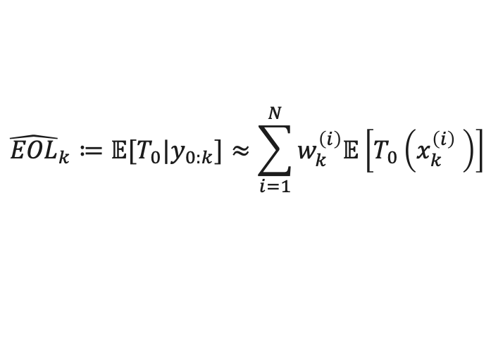
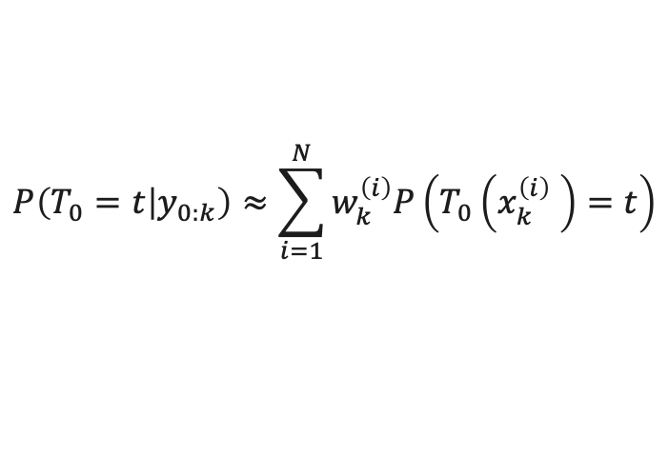
EOL Prediction
In particular, the EOL predictive distribution at time step $k$ can be approximated by
$$P\left(T_{0}=t | y_{0:k}\right)≈\sum_{i=1}^{N}{w_{k}^{\left(i\right)}P\left(T_{0}\left(x_{k}^{\left(i\right)} \right)=t\right)}$$
We compute the EOL prediction at time $k$ as the mean of the EOL predictive distribution:
$${\hat{EOL}}_{k}≔𝔼[T_{0}|y_{0:k}]≈\sum_{i=1}^{N}{w_{k}^{\left(i\right)}𝔼\left[T_{0}\left(x_{k}^{\left(i\right)} \right)\right]}$$
To compute a confidence interval at level $ℓ$, we find the quantiles $a$ and $b$ such that $P (a < T_{0} < b|y_{0:k}) = ℓ$.
Final prediction and uncertainty: At each time step, the EOL prediction and confidence interval are obtained by aggregating across performance metrics, using the earliest estimated failure time (mean or quantiles) as the system-level result.

Slide 14
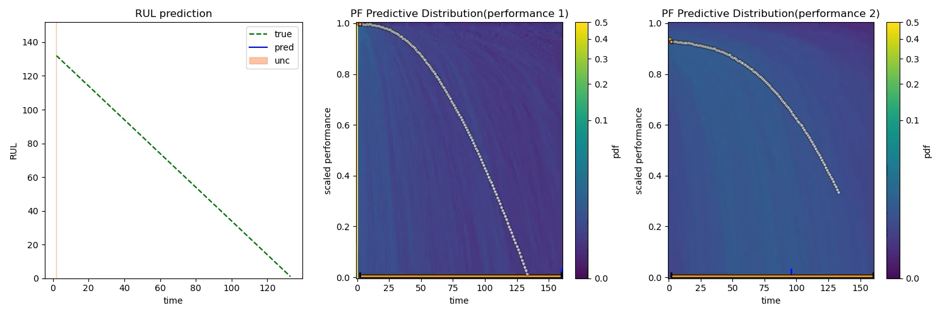
Predictive distribution

Slide 15

Performace model $T_{s}$

Slide 16
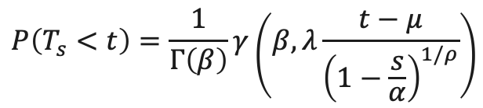
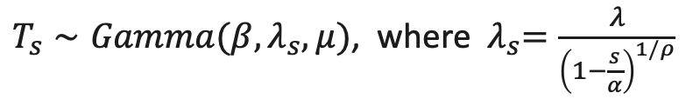
Performance model
We extended the Gamma parametric model presented in [1] to the shifted Gamma distribution.
$T_{s}∼Gamma(β,λ_{s}, μ)$, where ${ λ}_{s}=\frac{λ}{{\left(1−\frac{s}{α}\right)}^{1/ρ}}$
where the degradation parameters are $X=(β,λ,ρ,μ,α)$. The distribution of $T_{s}$ is given by
$$P\left(T_{s}<t\right)=\frac{1}{Γ\left(β\right)}γ\left(β,λ\frac{t−μ}{{\left(1−\frac{s}{α}\right)}^{1/ρ}}\right)$$
where $Γ$and $γ$denote the Gamma and lower incomplete Gamma functions.
In particular, the EOL distribution corresponds to $s = 0$, is given by: $T_{0}∼Gamma\left(β,λ, μ\right).$
[1] Dersin Pierre, Kristupas Bajarunas, and Manuel Arias-Chao. Analytical modeling of health indices for prognostics and health management. In PHM Society European Conference, volume 8, pages 11–11, 2024

Slide 17

Results

Slide 18
Dataset
Simulation platform: high-fidelity UAV (octo-rotor) model MATLAB/Simulink.
Models realistic dynamics, controls, and degradation behaviors
Includes wind disturbance and repeated mission cycles
Degrading components
8 motors (internal resistance)
1 battery (capacity & internal resistance)
Performance metrics
Battery SOC (failure threshold: 0.3)
Cumulative position error (failure threshold ≈ 1 m/s of flight time)
Dataset size
20 UAVs simulated to failure
15 units for training, 5 units for testing

Slide 19
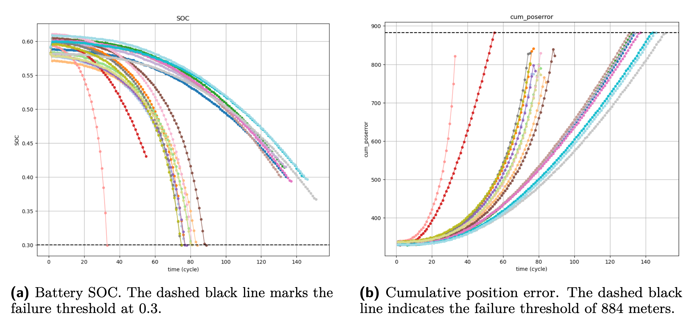
Dataset

Slide 20
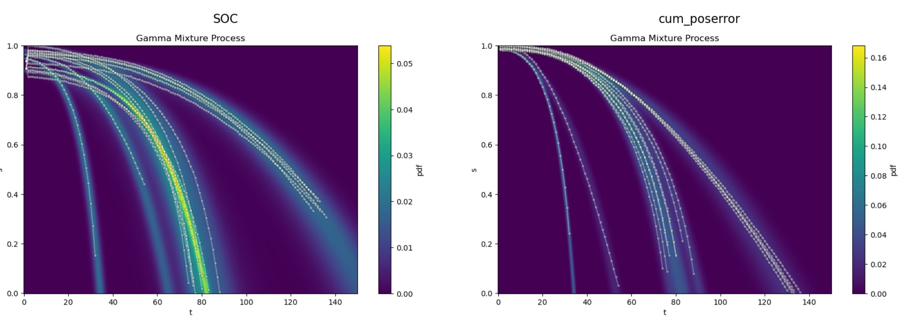

Initial distribution $P(X_{0})$

Slide 21
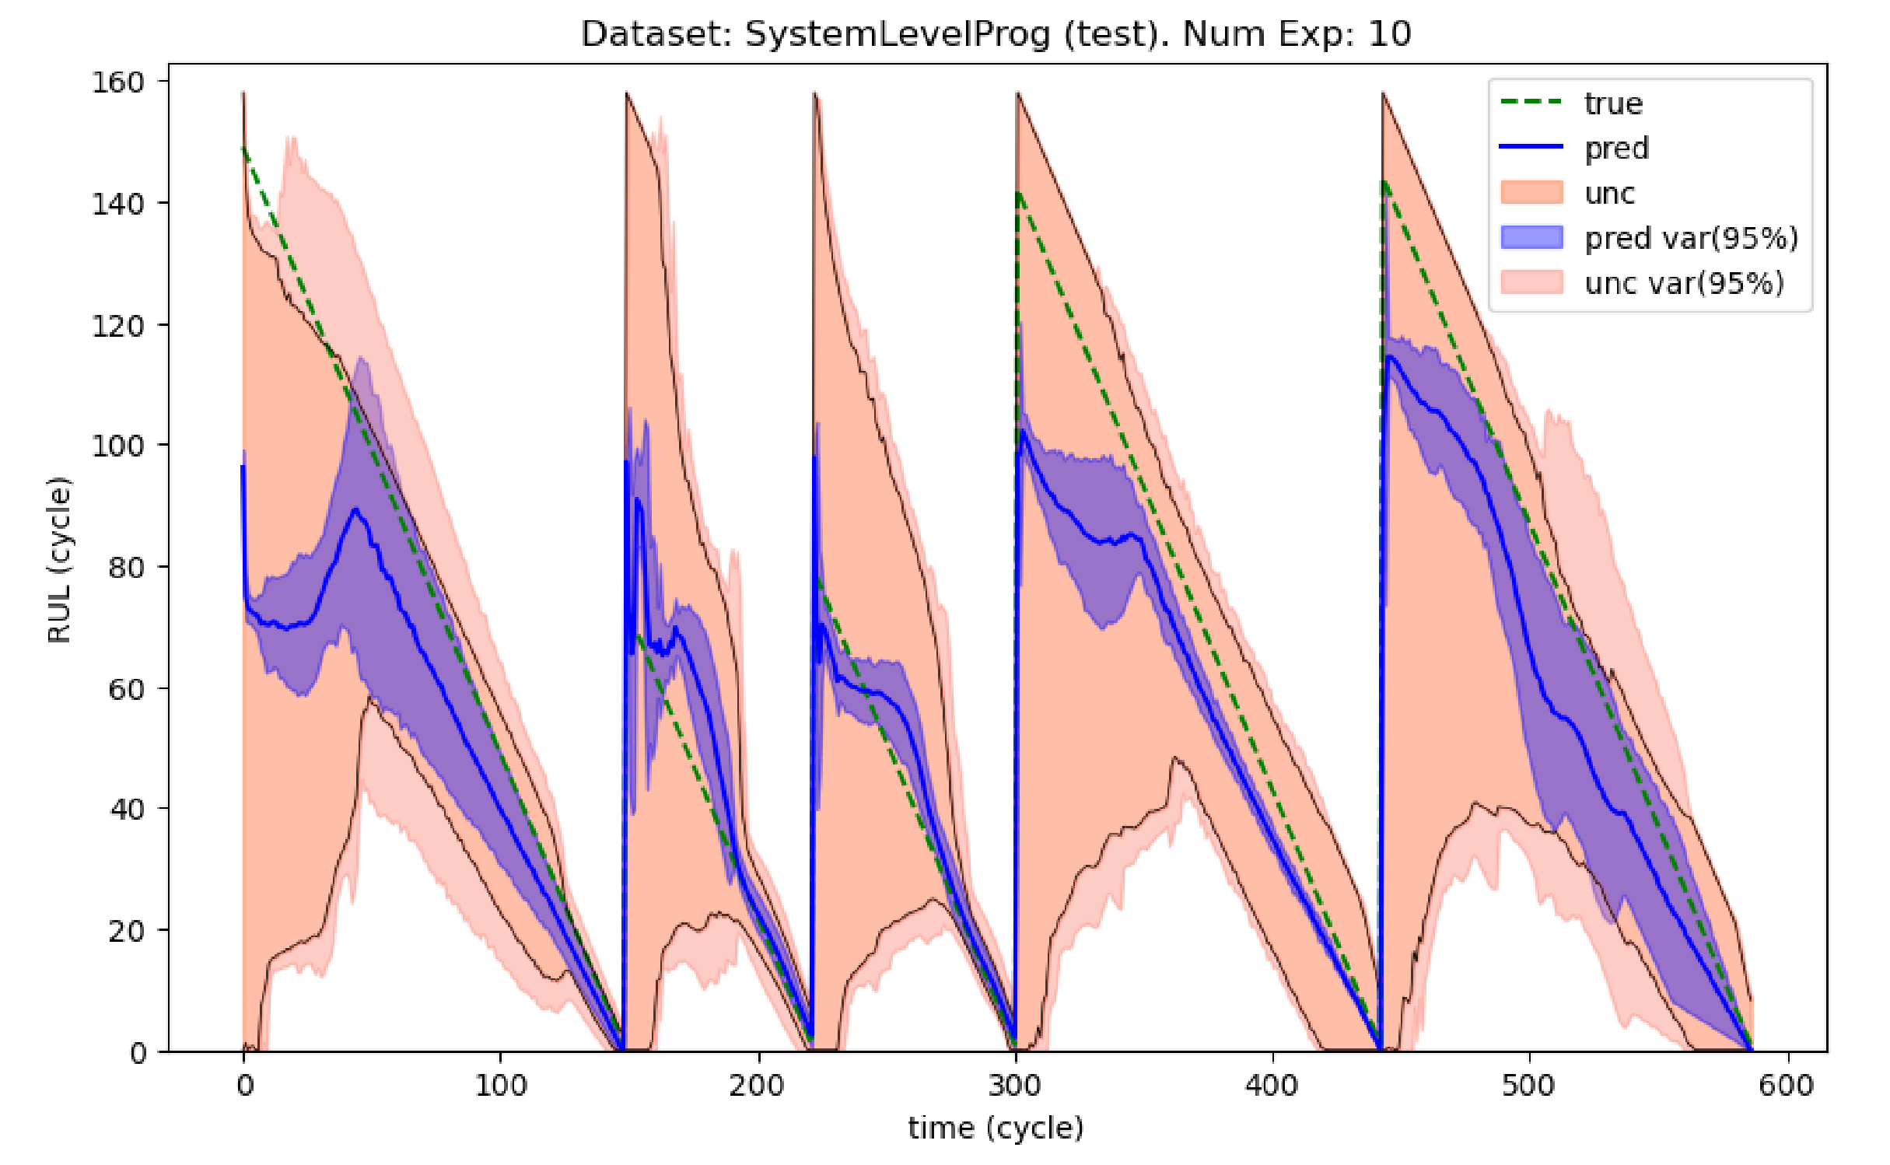
Predicted RUL

Slide 22
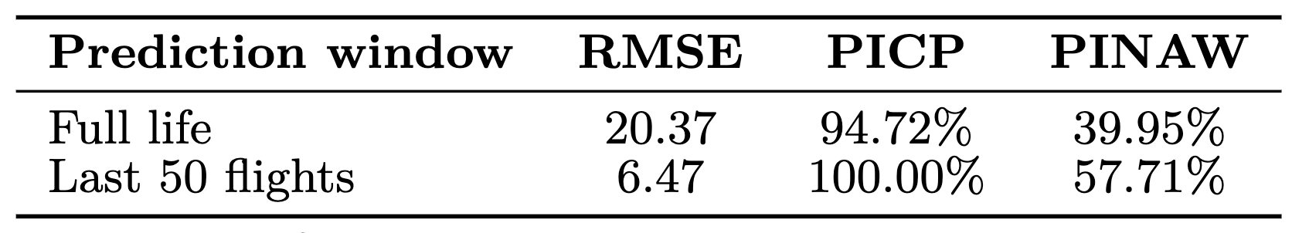
Evaluation
Evaluation metrics
RMSE – measures prediction accuracy
PICP – percentage of true RUL within prediction intervals
PINAW – width of prediction intervals (normalized)
The method becomes more accurate and reliable near failure, while still providing meaningful uncertainty estimates across the full life cycle.

Slide 23

Conclusions and
Future Work

Slide 24
Conclusion
Introduced a data-driven particle filtering framework for RUL prediction.
Works without requiring physical models, relying only on performance metrics.
Provides uncertainty-aware predictions, capturing both stochastic and epistemic uncertainty
Offers interpretability through performance-indexed degradation trajectories
Validated on a high-fidelity UAV simulation dataset.
Combines statistical rigor with data-driven flexibility, offering a principled alternative to black-box methods

Slide 25
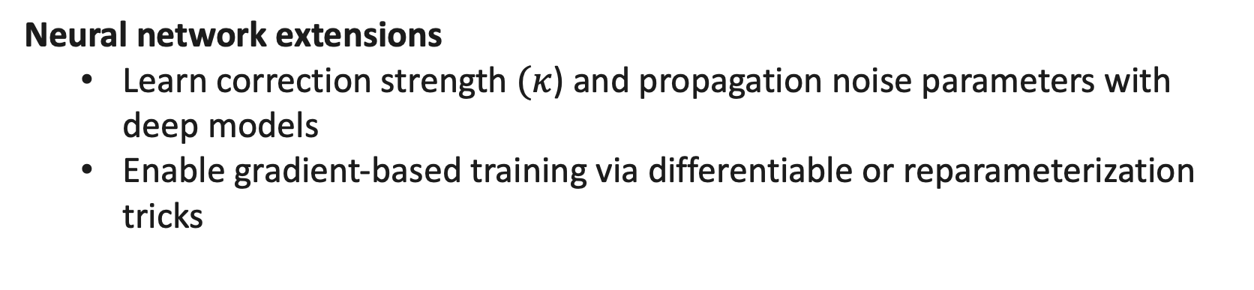
Future Work
Benchmark evaluation
Apply method to N-CMAPSS dataset and real-world data
Neural network extensions
Learn correction strength $(κ$) and propagation noise parameters with deep models
Enable gradient-based training via differentiable or reparameterization tricks

Slide 26
Thanks for listening!

